Slide 1

AUTHORING SYSTEM
- Group C -
Group Members:
Kelly Tan Kai Ling
Chan Jin Shuan
Ibrahim Faiz

Slide 2
Table of Contents
Here you can add something in brief as the explanation, this is a demo text which you can replace by your own content
Introduction
Prototype Design
What is authoring system?
Project statement & Project scope
1
User interface & Features
2
Development
Project Outcome
Development methodology,
Development Environment & Framework
3
Summary of achievements &
Problems Encountered
4
Future Plans
Conclusion
Possible improvements
5
Summary of project
6

Slide 3

What is Authoring System?
An authoring system is a software that allows users to create and customize digital content for online courses, e-learning modules or any other form of instructional materials without the need for technical skills.
It includes multimedia elements and interactive features, enabling efficient and effective creation and management of learning resources.

Slide 4
Authoring System VS
Learning Management System
A Learning Management System (LMS) is a platform for sharing and managing learning content among users.
An authoring system is a software program that allows users to create and publish digital courses.
It serves as a hub for uploading and distributing course materials and provides tools for monitoring and assessing user performance.
It includes tools for creating interactive and engaging content, such as multimedia elements and interactive assessments.
In summary, Learning Management System is a platform for managing and sharing learning content, while an authoring system is a tool for creating and publishing that content.

Slide 5
Problem Statement
Tech illiteracy among people, especially adults, is a significant cause of concern and has left many people disadvantaged when it comes to using modern education technology platforms.
Authoring systems are crucial tools for creating and managing digital content and are integrated with Learning Management Systems.
Usability and flexibility are two significant challenges in the design and development of authoring systems, particularly for non-technical users.
There is a need for a user-friendly system that supports various types of content such as text, images, audio, and video, and allows users to customize the content and layout according to their specific needs.

Slide 6
Solution
The objective of the project is to develop an authoring system that serves as a creation and publishing tool for a Learning Management System.
The authoring system must be user-friendly and allow untrained personnel to create and edit their own courses without requiring specialized technical expertise.
The system must integrate with the LMS platform to enable easy course publishing and management within the LMS environment.
The authoring system will have user-friendly tools, including a filter option, a search function, and personalization options for users to customize their learning experience.

Slide 7
Key Project Features
Course Creation
A new course page can be created and accessed from the navigation bar
File Upload and Delete
Files can be uploaded to the topic page and are sorted based on the file type
Filter based on Difficulty Level
Users can filter topics based on the difficulty level of the topic

Slide 8
Key Project Features
Search for Specific Files
Users can search for either a topic or course using the search bar
Clone Files
A copy of the topic can be created using the clone feature
View in User Mode
Creators can see how the learning material is viewed from the users’ perspective

Slide 9




Development Environment & Framework
Here you can add something in brief as the explanation, this is a demo text which you can
replace by your own content
APACHE
PHP
jquery
MySQL
server
Frontend + Backend
Backend
Database

Slide 10
Development Model & Process
Discussed with the client and set project requirements and timeline.
01
02
Adopted the scrum methodology for project management and split tasks into sprints.
Used GitHub for version control and source code management
03
04
Conducted Acceptance Testing to evaluate the quality of the product.

Slide 11
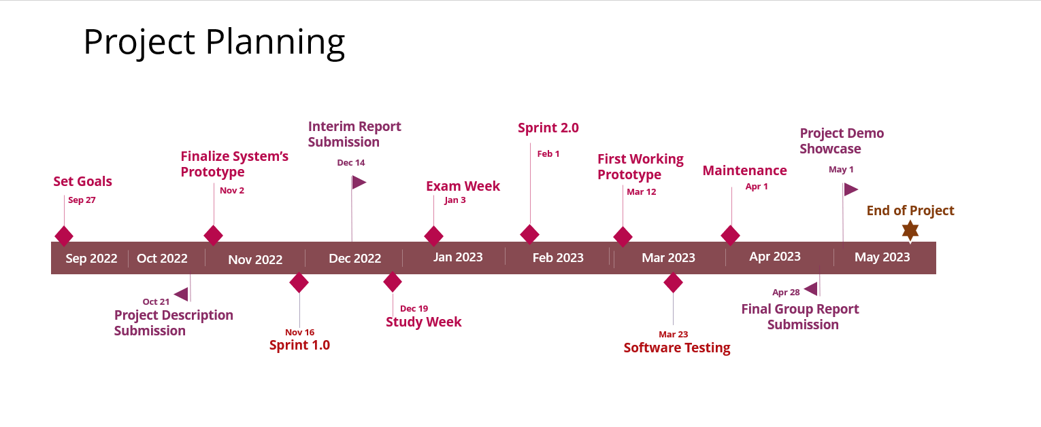
Time Chart
80%
60%

Slide 12
Achievements
With the development of Stud.io, we have created a user-friendly interface that serves both as a content creation and management platform for its users.
The system supports various types of content, including text, images, audio, and video, and allows users to customize the content and layout according to their specific needs.
The overall objective of creating an easy-to-use platform aimed at people with limited technology adeptness has been fulfilled.

Slide 13

Problems Encountered
Need for Server Hosting
Needed to host the application on a server to make it viable. Fixed the issue by getting access to the Mercury server from the university.
File Storage
MySQL only accepts files that are 64kb or smaller, which is not ideal for the project. Files therefore needed to be stored locally.
Departure of a Group Member
Learnt halfway through the project that a group member had to quit university due to personal reasons, which meant the initial planning had to be reconsidered.
Limited Access to other LMS Platforms
Many websites could be accessed only through pain subscriptions, which made it slightly difficult to get access to them. Overcame this by using free trials.

Slide 14
Technical Challenges Faced

Slide 15
Possible Improvements
Course Sharing
Allow users to share courses with each other
Download files
Allow users to download files from the website
Calendar
Display a calendar to allow users to allot courses or topics to specific dates
Quizzes
Include quizzes as a file type under the topic page
Comment section under the files
Have a comment section where users studying the same topic can discuss with each other
Reset Password System using Email Verification
Allow users to reset their passwords through a password recovery link sent to their emails.

Slide 16
Reflection

Slide 17
Our Team
Kelly Tan Kai Ling
Chan Jin Shuan
Ibrahim Ahmad Faiz

Slide 18

THANK YOU
- Group C -

Slide 19

Q&A SESSION

